Slide 1

Research Report
Eoin Dalton
20070289

Slide 2
Metasploit a Brief History
Metasploit was created by HD Moore in 2003.
His vision was to build a tool that even novice users could use.
Moore originally wrote Metasploit in the programming language called Perl.
But in version 3, Metasploit was re-written in the powerful scripting language called Ruby.
In 2009 it was taken over by Rapid 7.
Rapid 7 has since released commercial version aimed at security professionals.

Slide 3
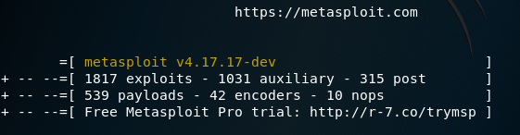
What is Metasploit
Metasploit is one of many tools used by people interested in computer security.
Kali Linux, Wireshark, nmap are some other examples of security tools.
Metasploit is a framework that is built for users to carry out penetration testing.
If you see the screen grab below taken from Metasploit, it lists 1817 different built in exploit’s and 539 different payloads ready for tester to use.
Payload is the script sent to
exploit the target machine.

Slide 4
What is Metasploit
Metasploit is used through a command line interface.
Metasploit can be used along with other tools such as Armitage which has a graphical interface for easy use.
A module is used in Metasploit to preform some operation such as scanning or exploiting.
There is a search option in Metasploit that allows users to search for modules, a user may search by a CVE number or an operating system.
Example:
This will bring back all exploits for a Windows XP OS running version service pack 3.

Slide 5
Experiments
For my Experiment I used Metasploit through a Kali Linux virtual machine.
I downloaded a Metasploitable virtual machine, this is a virtual machine from Metasploit that is purposely designed to be exploitable for penetration testing.
The exploit I used was to gain access was unreal_ircd_3281backdoor.
This was a flaw on port 6667 which runs an IRC server (Internet Chat Relay) which was later patched.
This allows users on a IRC sever to communicate via text.

Slide 6
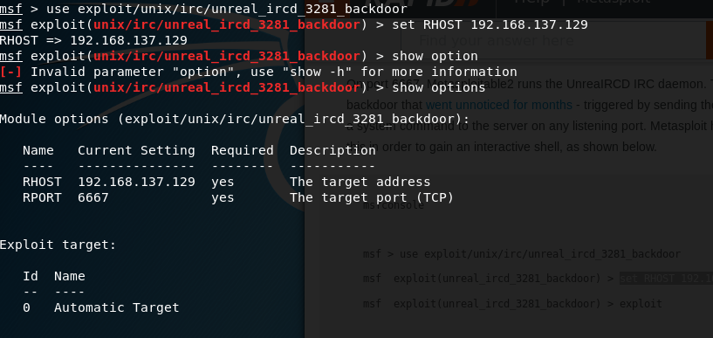
Experiments
Using Metasploit this only took three command and I had access to the Metasploitable machines seen in the screenshot to the right..
use exploit/unix/irc/unreal_ircd_3281backdoor
Set RHOST 192.168.137.129

Slide 7
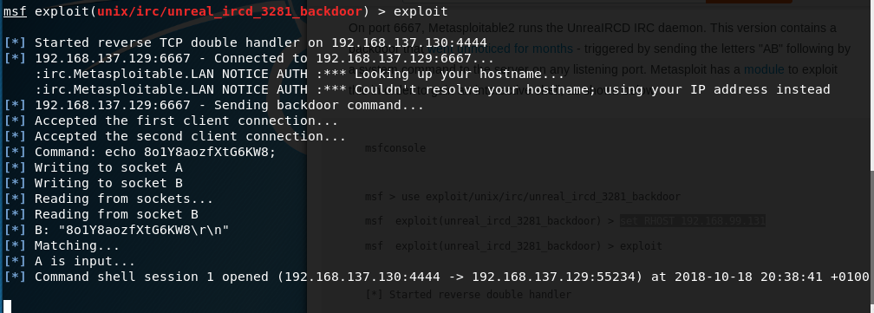
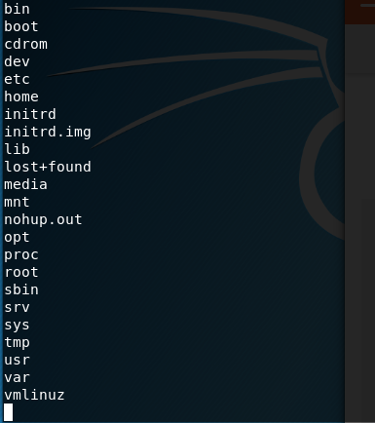
Experiments
The next command was just exploit as you can see from the screen grab it then makes the connects to the vulnerable machine.
After this command I now had access to the vulnerable machine.
I then used the ls command to list all the directories on the machine

Slide 8
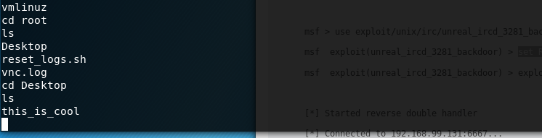
Experiments
Finely I created a folder on the target machine called “this is cool” so that I could test to see if the vulnerability worked, as you can see from the screen grab the folder I created was on the desktop as seen below.

